Slide 1
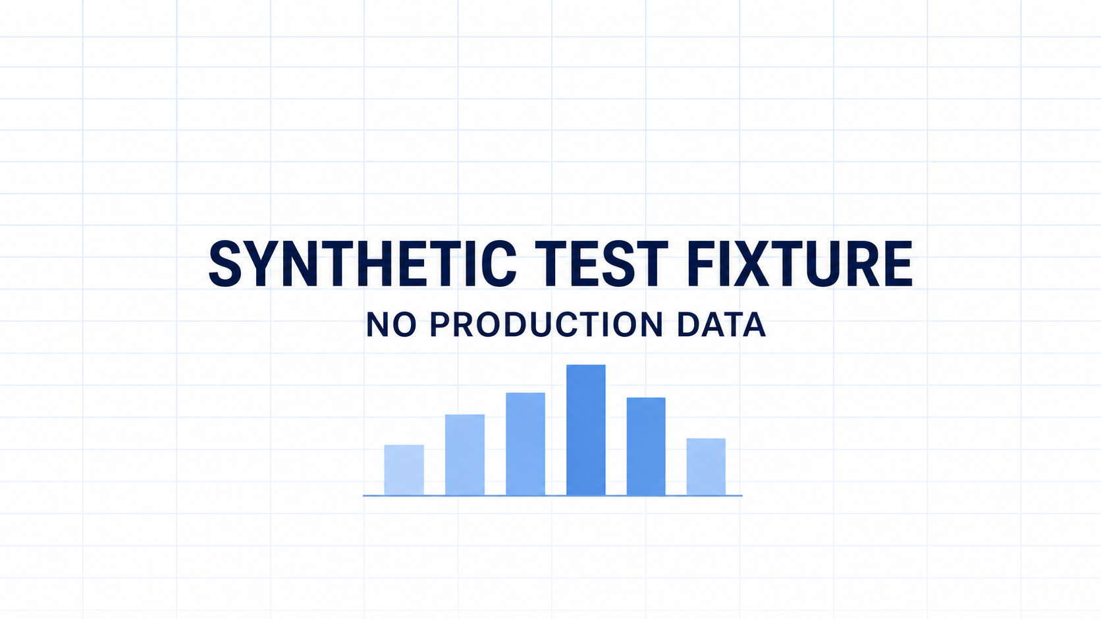
Counterparty Exposure All Programs
Notes:
[Synthetic fixture: chart values and screenshots contain no production data.]

Slide 2
Notes:
[Synthetic fixture: chart values and screenshots contain no production data.]

Slide 3
Notes:
[Synthetic fixture: chart values and screenshots contain no production data.]

Slide 4
Notes:
[Synthetic fixture: chart values and screenshots contain no production data.]

Slide 5
Notes:
[Synthetic fixture: chart values and screenshots contain no production data.]

Slide 6
Counterparty Exposure excluding Trend
Notes:
[Synthetic fixture: chart values and screenshots contain no production data.]

Slide 7
Notes:
[Synthetic fixture: chart values and screenshots contain no production data.]

Slide 8
Notes:
[Synthetic fixture: chart values and screenshots contain no production data.]

Slide 9
Notes:
[Synthetic fixture: chart values and screenshots contain no production data.]

Slide 10
Notes:
[Synthetic fixture: chart values and screenshots contain no production data.]

Slide 11
Notes:
[Synthetic fixture: chart values and screenshots contain no production data.]

Slide 12
Notes:
[Synthetic fixture: chart values and screenshots contain no production data.]

Slide 13
Notes:
[Synthetic fixture: chart values and screenshots contain no production data.]

Slide 14
Notes:
[Synthetic fixture: chart values and screenshots contain no production data.]

Slide 15
Notes:
[Synthetic fixture: chart values and screenshots contain no production data.]

Slide 16
Counterparty Exposure Trend
Notes:
[Synthetic fixture: chart values and screenshots contain no production data.]

Slide 17
Notes:
[Synthetic fixture: chart values and screenshots contain no production data.]

Slide 18
Notes:
[Synthetic fixture: chart values and screenshots contain no production data.]

Slide 19
Notes:
[Synthetic fixture: chart values and screenshots contain no production data.]

Slide 20
Notes:
[Synthetic fixture: chart values and screenshots contain no production data.]

Slide 21
Notes:
[Synthetic fixture: chart values and screenshots contain no production data.]

Slide 22
Notes:
[Synthetic fixture: chart values and screenshots contain no production data.]

Slide 23
Notes:
[Synthetic fixture: chart values and screenshots contain no production data.]

